Slide 1
19CS3113S
Analysis and Design of Algorithms
Session -24

Slide 2
Graph Traversals
  Breadth first Search and Traversal.
  Depth first Search and Traversal.

Slide 3
Breadth first search
In Breadth First Search we start at a vertex ‘v’ and mark it as having been reached (visited).
The vertex ‘v’ is at this time said to be unexplored.
A vertex is said to have been explored by an algorithm when the algorithm has visited all vertices adjust from it.
All unvisited vertices adjust from ‘v’ are visited next. These are new unexplored vertices.
Vertex ‘v’ has now been explored. The newly visit vertices have not been explored and are put on the end of a list of unexplored vertices.
The first vertex on this list in the next to be explored. Exploration continues until no unexplored vertex is left.
The list of unexplored vertices operates as a queue and can be represented using any of the start queue representation.

Slide 4
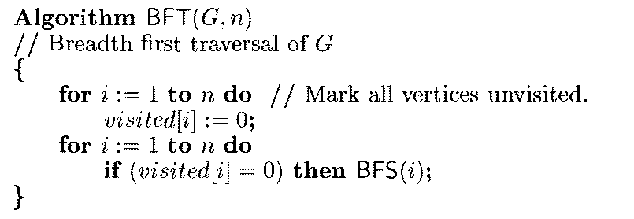

Slide 5
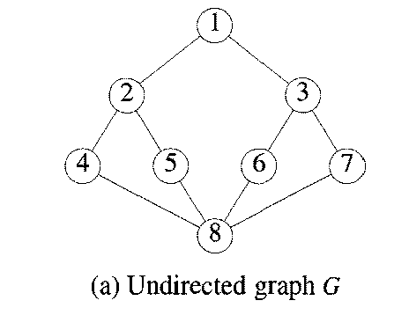
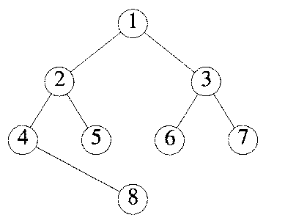
BFS Of Graph G

Slide 6
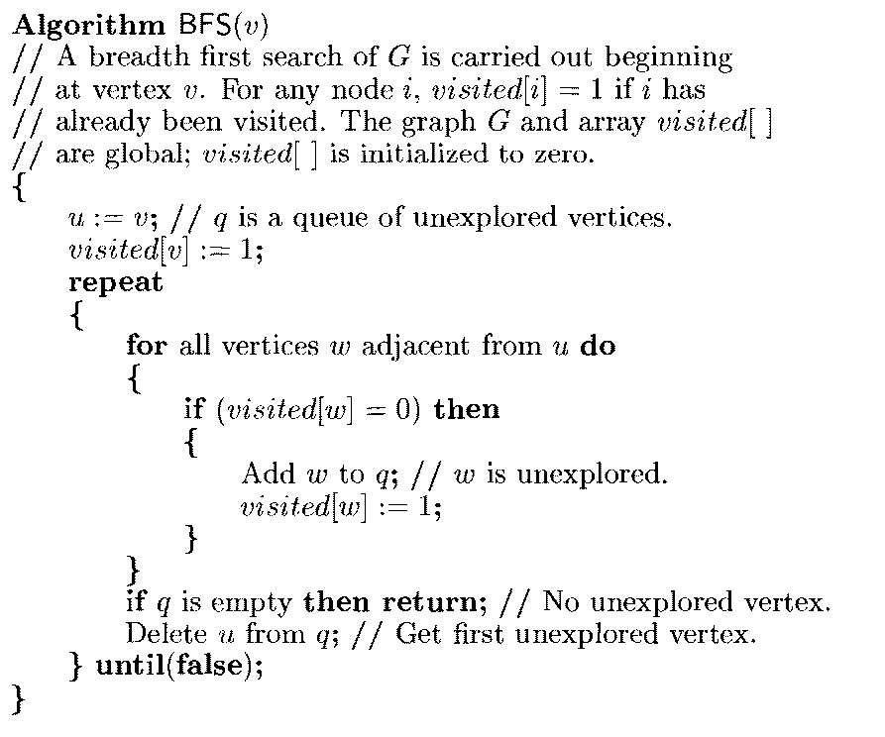

Slide 7
Applications of BFS
BFS can be used to determine whether G is connected.
-If G is a connected undirected graph, then all vertices of G will get
visited on the first call to BFS Algorithm .
-If G is not connected, then at least two calls to BFS will be needed.
The connected components of a graph can be obtained using BFT.
BFT can also be used to obtain the reflexive transitive closure matrix
of an undirected graph G.
-If A* is this matrix, then j) = 1 iff either i = j or i # j and i and j are in the same connected component.
BFS can also be used to obtain spanning trees.
- spanning tree obtained using BFS is known as breadth first spanning tree.

Slide 8
DEPTH FIRST SEARCH
A depth first search of a graph differs from a breadth first search in that the exploration of a vertex v is suspended as soon as a new vertex is reached.
At this time the exploration of the new vertex u begins. When this new vertex has been explored, the exploration of u continues.
The search terminates when all reached vertices have been fully explored. This search process is best-described recursively.

Slide 9
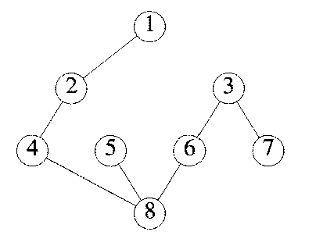
DFS Of Graph G

Slide 10
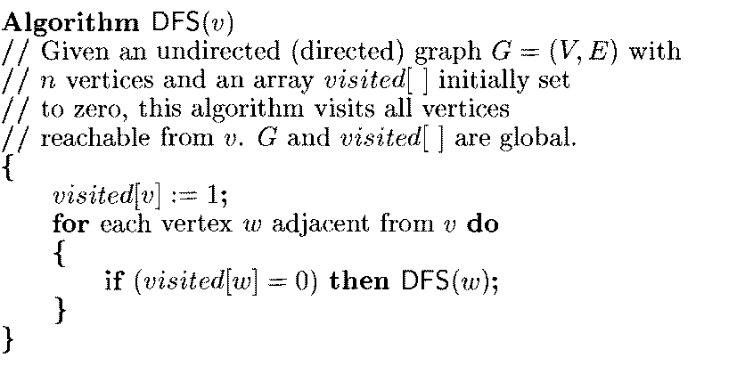

Slide 11
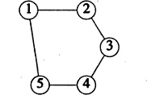
Applications of DFS
DFS can be used to determine whether G is Bi-connected.
- A graph G is Bi-Connected if it does not contain articulation
points.
Example
DFS can also be used to obtain spanning trees.
- spanning tree obtained using DFS is known as depth first spanning tree.

Slide 12
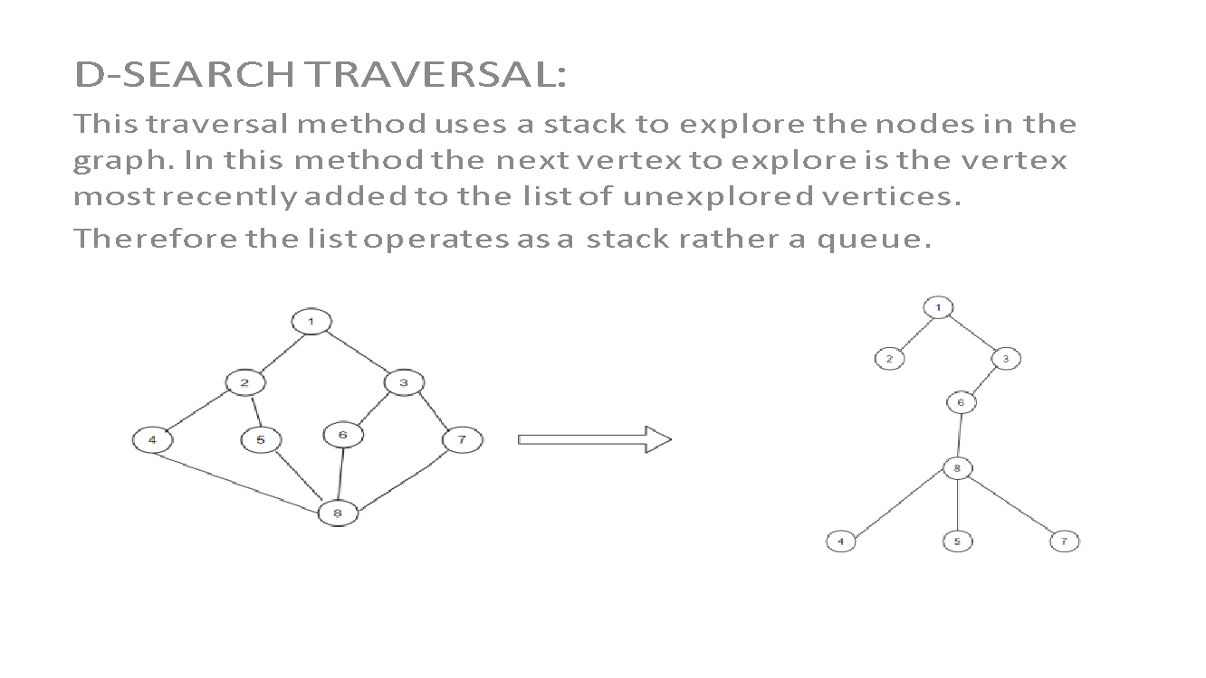

Slide 13
Thank you

